Slide 1


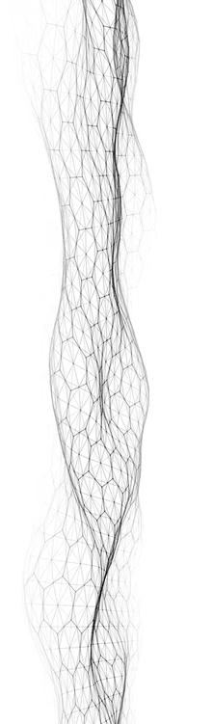

CREWES Data Science
Lecture 7: Projects Setup
Marcelo Guarido
www.crewes.org

Slide 2

Today's Agenda
Part 1:
Group Setup
Part 2:
Projects Oversiews
Part 3:
Questions

Slide 3


Part 1:
GROUP SETUP

Slide 4
Group 1:
Junxiao Li
Ligia Elena Jaimes
Hamid Akbay
Daniel
https://www.kaggle.com/datasets/alancmathew/anime-dataset

Slide 5
Group 2:
David Emery
Nazhat Shirin Rashid
Stephanie Misailidis
Reginaldo Moreira
https://www.kaggle.com/competitions/restaurant-revenue-prediction

Slide 6
Group 3:
Itzel Lucio Martinez
Xin Qiao
Hur Kazmi
Tiago Madureira Ruiz de Toledo
https://www.kaggle.com/datasets/rashikrahmanpritom/heart-attack-analysis-prediction-dataset

Slide 7
Group 4:
Jinji Li
Lucas Strujak
Yuan Yue (Catherine)
Natalia Coelho de Sena
https://www.kaggle.com/datasets/dhanushnarayananr/credit-card-fraud

Slide 8
Group 5:
Leonardo Queiroz
Nusrat Rani
Anita Wong
Ian Martins
https://www.kaggle.com/datasets/mdmahmudulhasansuzan/students-adaptability-level-in-online-education

Slide 9

Part 2:
PROJECTS OVERVIEWS

Slide 10

Group 1: Anime Ratings Prediction
What are the top rated anime?
Are there specific genres or studios that influence in the rating?
Create a regression model to predict the ratings.
What are the most important features?
Are the descriptions important to predict the ratings?
https://www.kaggle.com/datasets/alancmathew/anime-dataset

Slide 11

Group 2: Restaurant Revenue Prediction
What are the places with the highest restaurant revenue? Can you average by the city population? (Google search is required)
How do the Ps columns influence in the revenue?
Can you cluster the data and find groups profiles?
Train a regression model to predict restaurant revenue
What are the most important features?
https://www.kaggle.com/competitions/restaurant-revenue-prediction

Slide 12
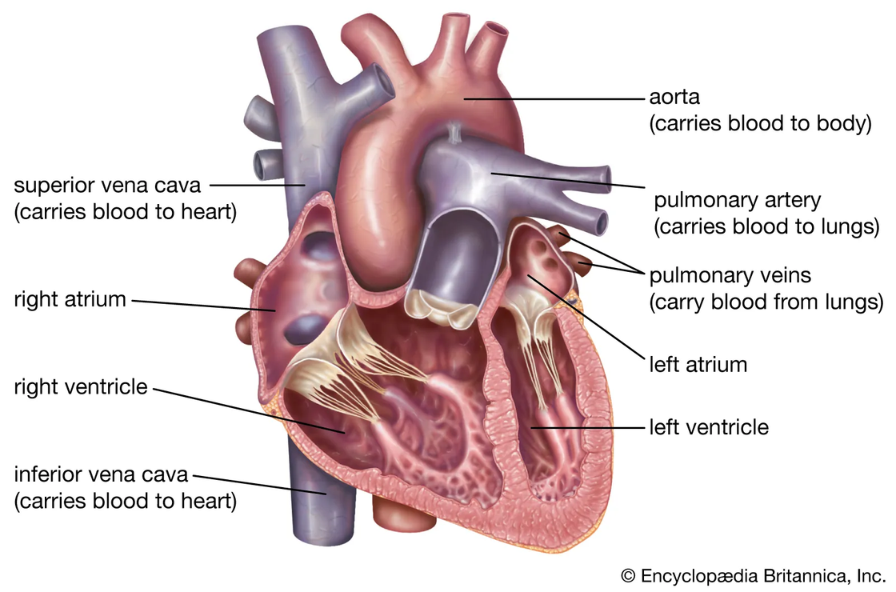
Group 3: Heart Attack Prediction
Are there any features that point higher risk of heart attacks?
Are heart attack risks different for each gender?
Can the data be clustered to identify different profile groups?
Train a classification model to predict the likelihood of a heart attack.
What are the most important features?
https://www.kaggle.com/datasets/rashikrahmanpritom/heart-attack-analysis-prediction-dataset

Slide 13

Group 4: Credit Card Fraud Detection
What is the average ratio of purchase for fraudulent transactions?
Can EDA point to features and behaviours of fraudulent transactions?
Can clustering the data be used to identify profile groups?
Create a classification model to predict frauds in transactions.
What are the most important features?
https://www.kaggle.com/datasets/dhanushnarayananr/credit-card-fraud

Slide 14

Group 5: Online Education Adaptability Prediction
From EDA, is there any difference between education level and adaptivity level?
How does financial condition and internet type influence in the online education for the students?
Cluster the data and identify different group profiles.
Create a classification model to predict students' adaptability
What are the most import features?
https://www.kaggle.com/datasets/mdmahmudulhasansuzan/students-adaptability-level-in-online-education

Slide 15

Part 4:
QUESTIONS

